Slide 1
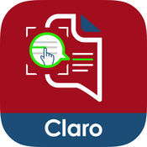
Claro ScanPen Reader
By Claro Software Limited
Use Claro ScanPen to read your printed text for you.
App is designed for both iPhone, iTouch and iPad
App Costs €6.99
Category: Education
Updated 04 August 2017
Size 119MB

Slide 2
Languages
Claro ScanPen Reader
Works with 21 Languages:
English, Arabic, Danish, Dutch, French, German, Indonesian, Italian, Japanese, Korean, Norwegian Bokmål, Polish, Portuguese, Russian, Simplified Chinese, Spanish, Swedish, Traditional Chinese, Turkish, Vietnamese

Slide 3
Uses
Use the Claro ScanPen Reader
to read back:
Printed text books
Handouts / printed presentations
Newspapers
Letters
Workbook
Exam papers
Instructions
Signs
Great for independent access to and learning

Slide 4
Internet
Claro ScanPen Reader does not need an internet connection.
It does not have any reference material like dictionary or thesaurus, so is perfect to use as a read aloud tool under exam and test conditions, helping students who cannot read text very well (e.g. students with dyslexia) to listen to the exam test paper questions and information.

Slide 5
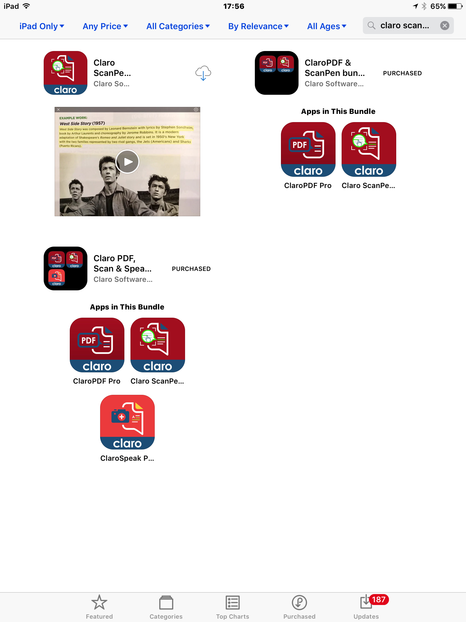
Step 5:
Download the App from the App store

Slide 6
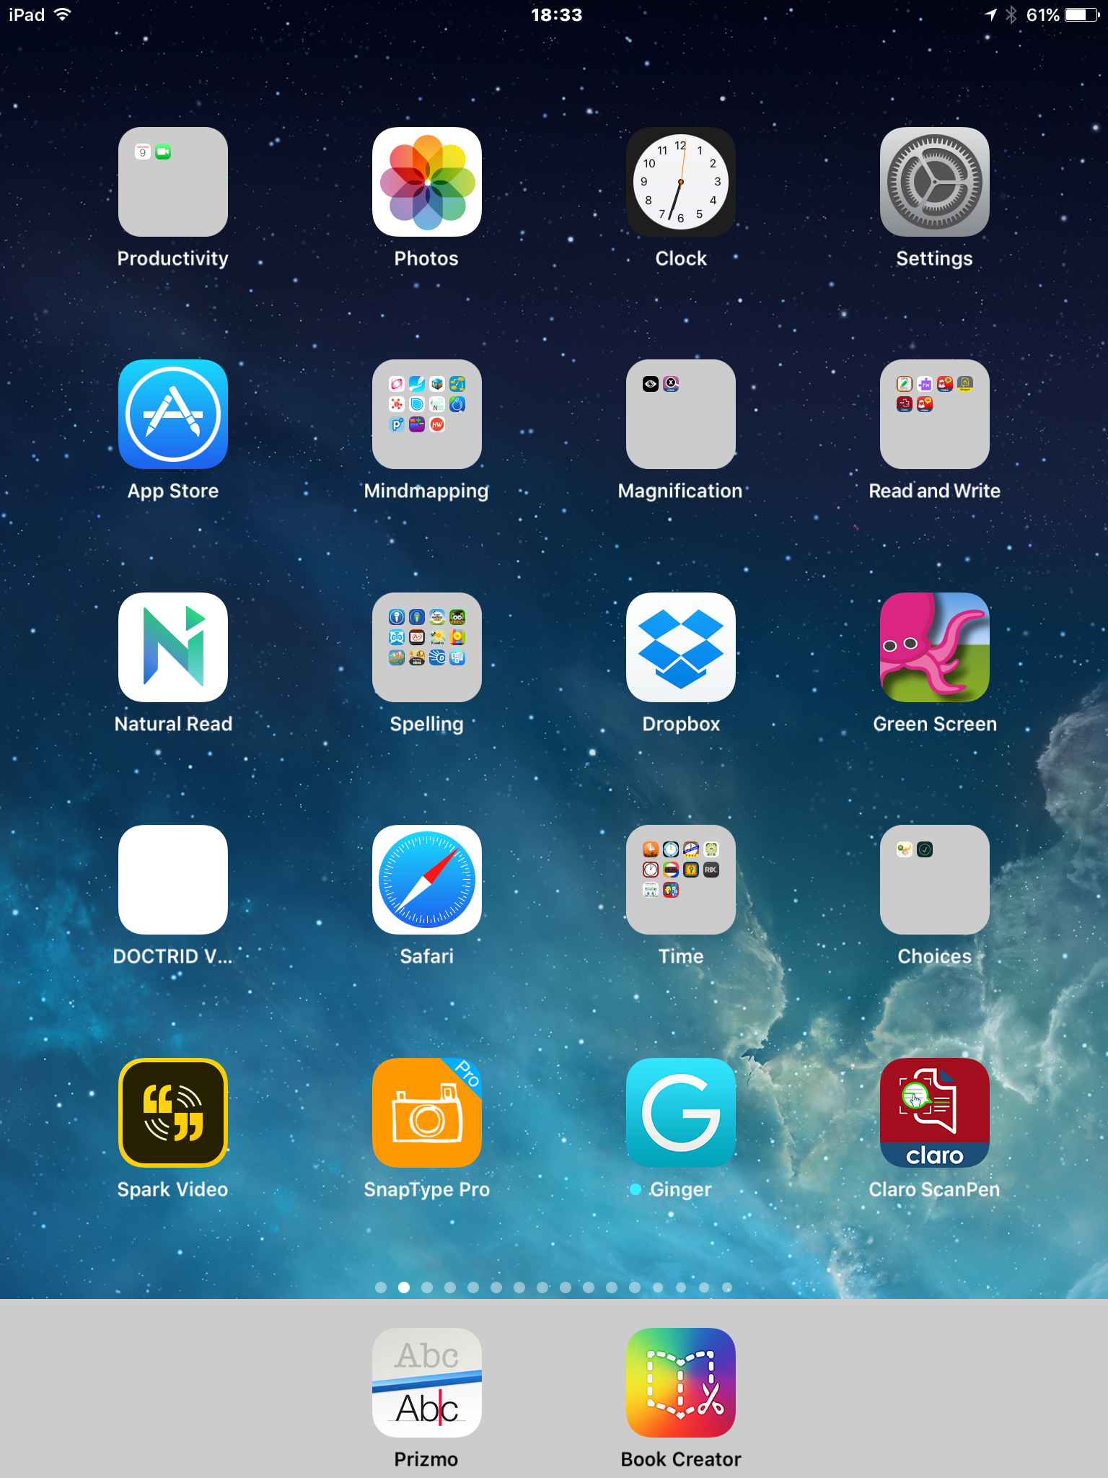
Step 6:
Tap on the App icon on the home screen to open the App

Slide 7
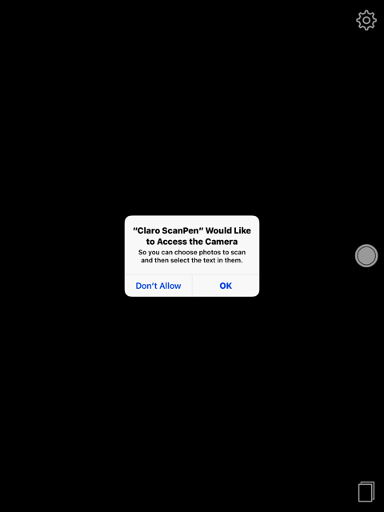
Step 7:
The first time you open the app you will be asked if the app can access the Camera. Tap OK

Slide 8
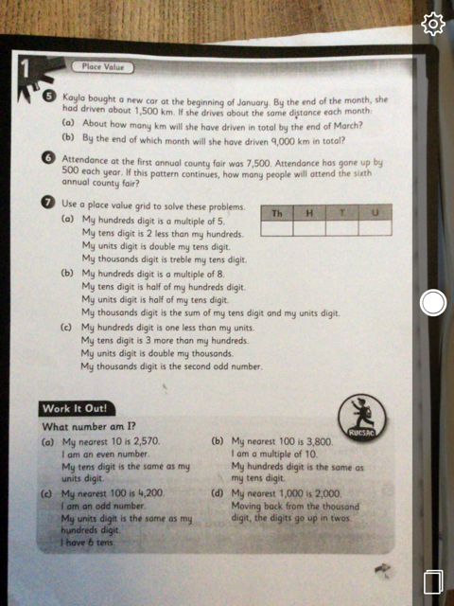
Step 8:
The camera will turn on automatically.
You must take a photo of the text you want the app to read.
The clearer the photo the better the text to speech.

Slide 9
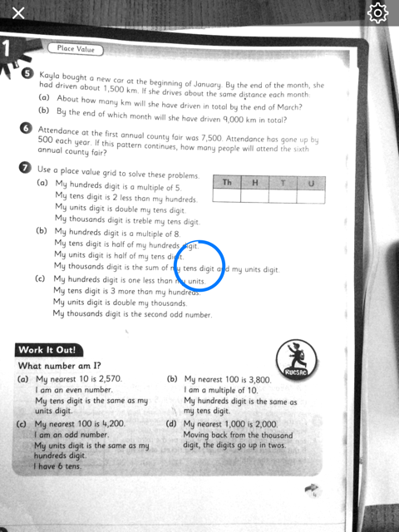
Step 9:
The app will then preform OCR to allow it to identify the words.
Wait for the tick
to appear.

Slide 10
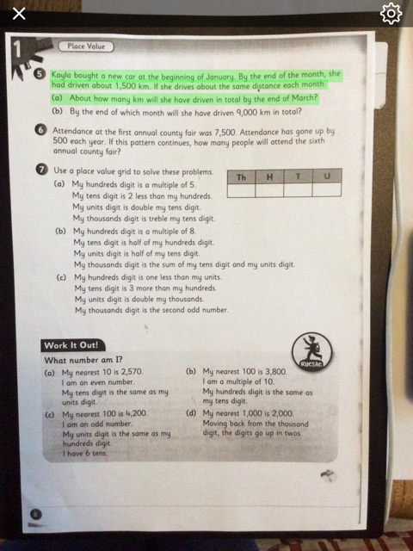
Step 10:
With your finger or stylus select the text you want read out.
Tap, hold and drag your finger from just above the first word until after the last word.
Lift you finger and the text will be spoken

Slide 11
Step11:
Lift your finger and the text will be spoken immediately.
Tap the screen if you want to stop the audio.

Slide 12
Step 12:
Tap on Settings wheel to change speed voice and activate advanced settings.

Slide 13
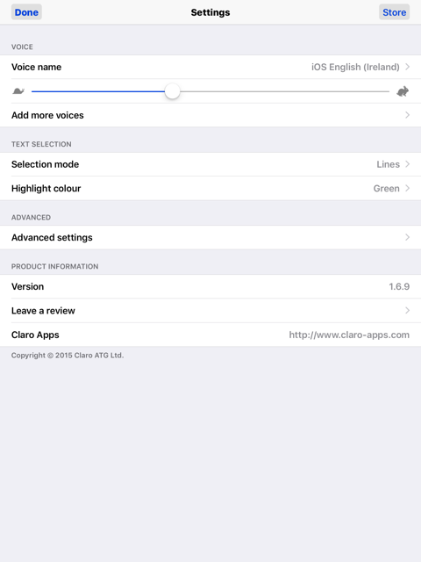
Step 13:
You can change the speed in which the text is spoken by tap hold and drag the slider.
You can change the voice and select between word or line selection.
You can also change the highlight colour to support those affected by visual stress and have identified a colour overlay that works for them.

Slide 14
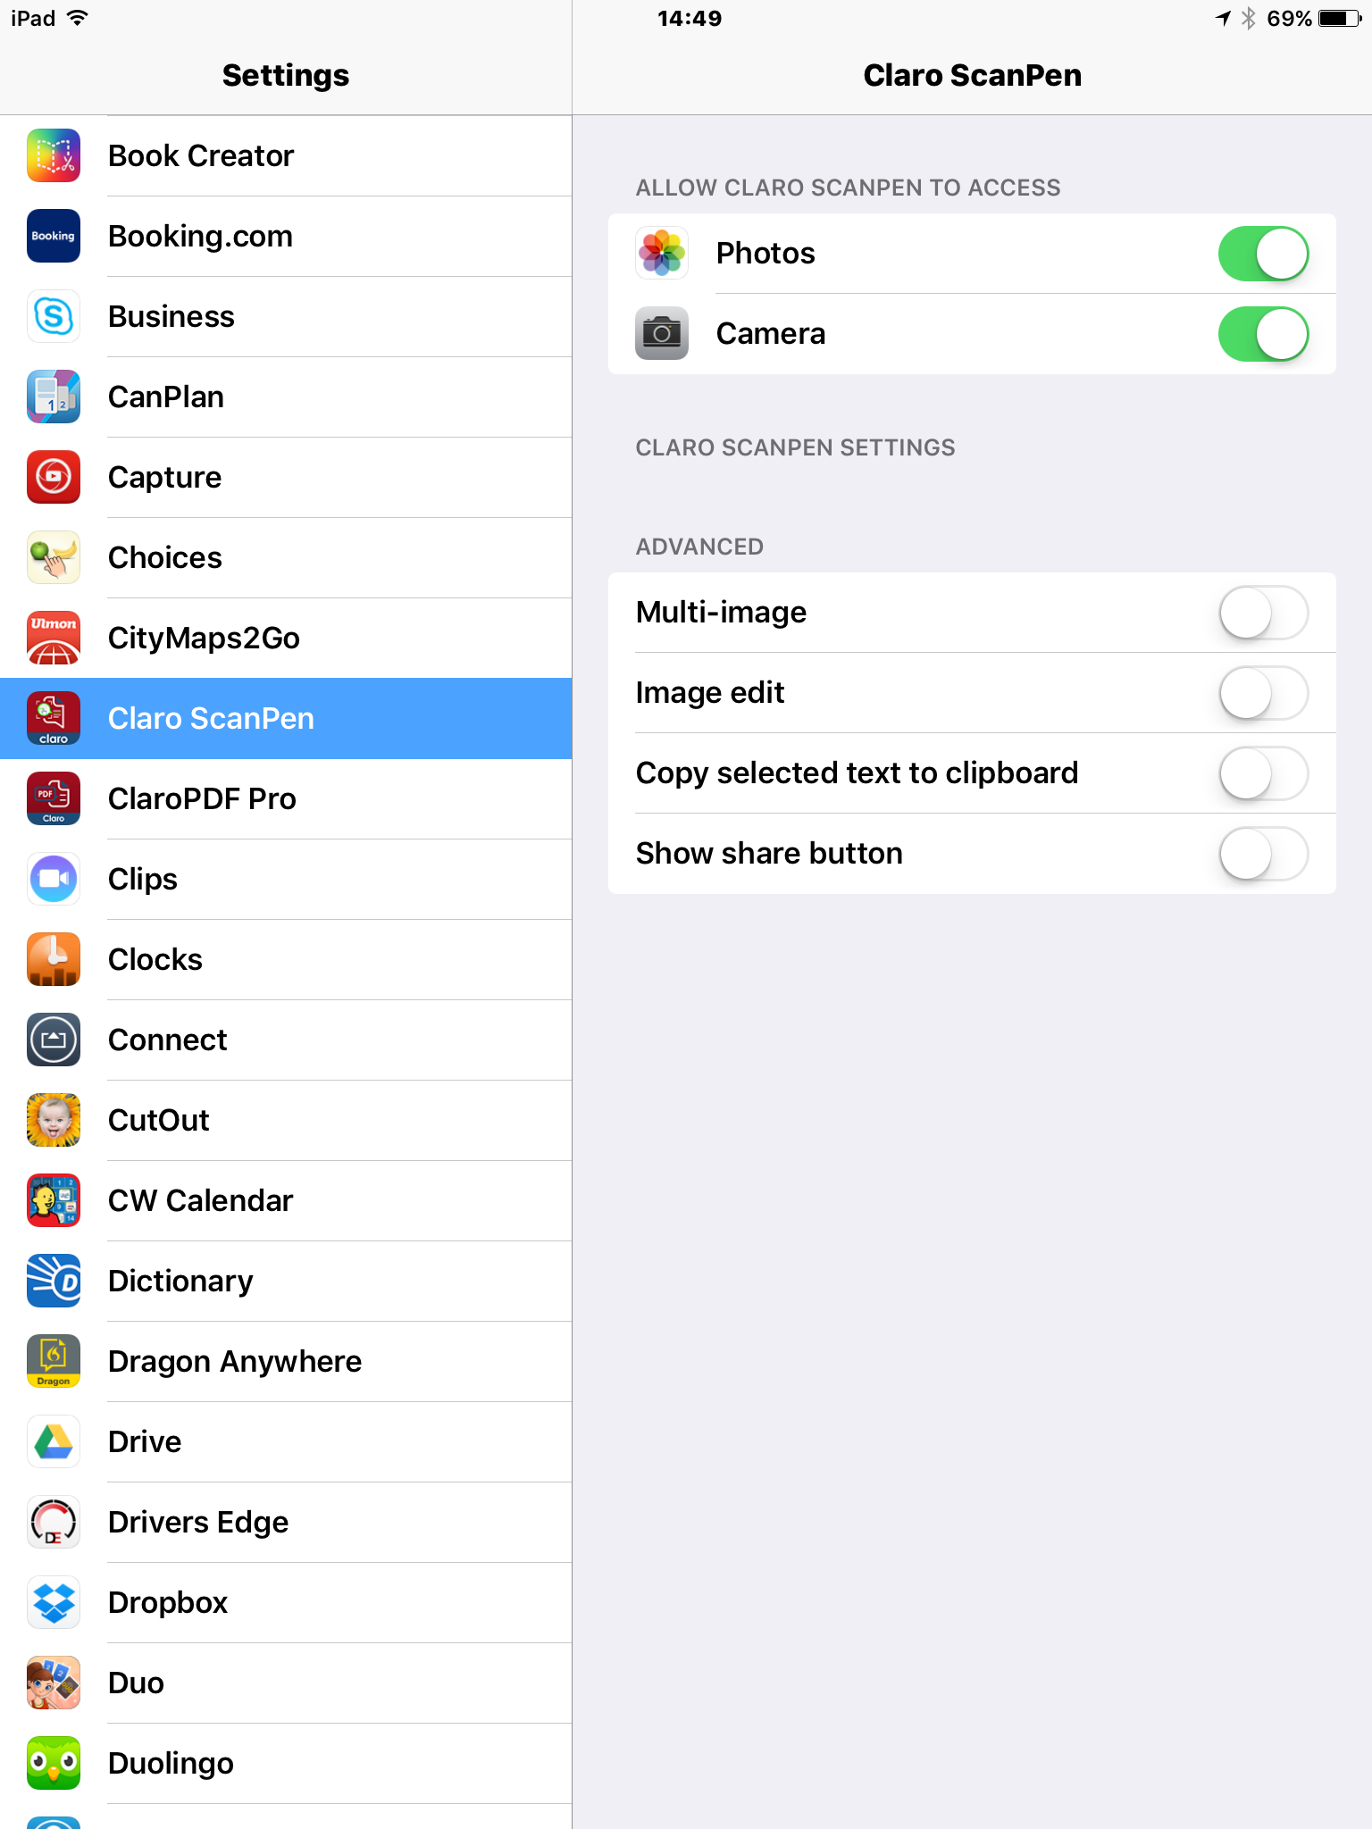
Step 14:
Turn on the advanced settings to access the advanced features; multi-image, image edit, copy text, show share button.

Slide 15
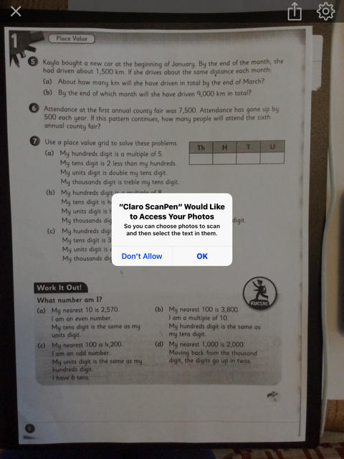
Step 15:
The share button lets you export your image to other apps, email and other destinations.
You must first allow Claro ScanPen to access your photos and tap OK
Selected text can be copied to the clipboard once it has been enabled in the advanced setting. Open up any text editor tap, hold and select Paste

