Slide 1
Tablet technology provides new tools to support All Learner Types.

Slide 2
During this module we covered these
Literacy Apps
Claro ScanPen Text to Speech
SnapType Content engagement support writing
Page : Ginger Spelling & Grammar support
Page
How do they work together to support students?

Slide 3
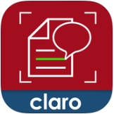
Literacy
apps
working
together
1. Use the Claro ScanPen Reader App to read out printed handouts or books.
3. To check spelling or grammar copy and paste text into Ginger Page Writing App
2. To fill out handouts or exams use ScanType Pro. Take a photo of the worksheet and fill it in by tapping on the blanks and typing your answer.

