Slide 1
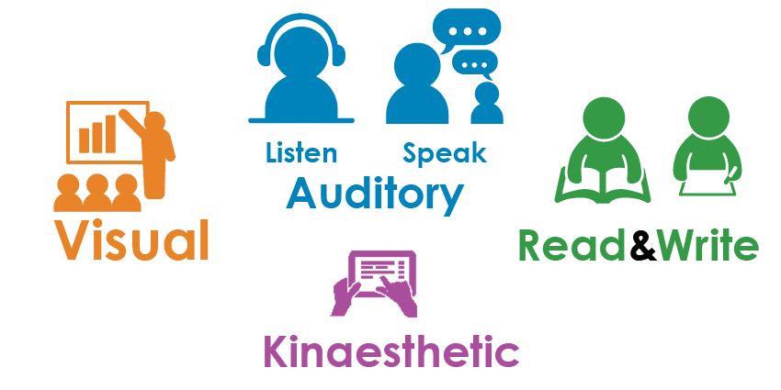
Tablet technology provides new tools to support All Learner Types.

Slide 2



During this module we covered these
Literacy Apps
Claro ScanPen
Text to Speech
SnapType
Content engagement support writing
Page : Ginger
Spelling & Grammar support
Page
How do they work together to support students?

Slide 3
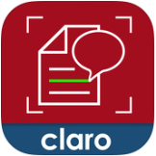


1. Use the Claro ScanPen Reader App to read out printed handouts or books.
3. To check spelling or grammar copy and past text into
Ginger Page Writing App
2. To fill out handouts or exams use ScanType Pro. Take a photo of the worksheet and fill it in by tapping on the blanks and typing your answer.

