Slide 1
About Me
My good day

Slide 2
In this module we will introduce learners to the first steps of applying person centred teaching in practice.

Slide 3
David Test “Self-Advocacy Model”
Knowledge of Self
Knowledge of Rights
Communication
Leadership

Slide 4
Multimedia Advocacy Approach
PCP principles
PCP values
Use multimedia
Follow self-advocacy model

Slide 5
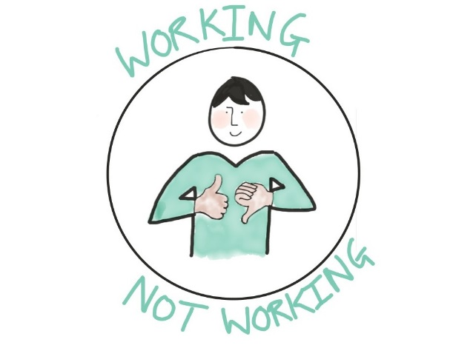
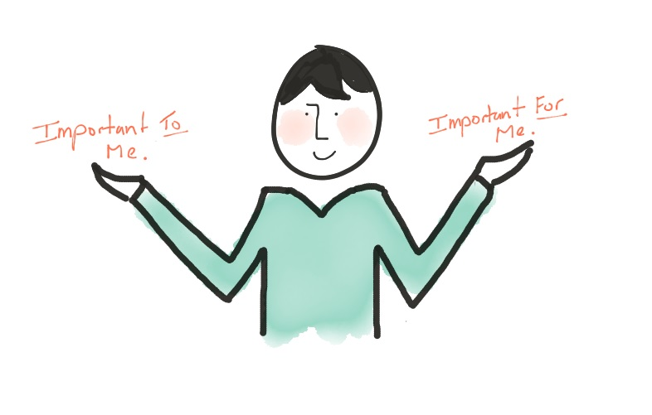
All about me!
Person-centred planning tools
Like and admire
Gifts, talents and interests
What is working/not working
Good day/Bad day
Important to/Important for
Relationship circle
What motivates me etc.

Slide 6
Good day - Bad day
Learner
What is important to me in school?
What makes me a better learner?
Staff listens to me and supports me

Slide 9
Good day - Bad day
Parents
Good day/bad day
Important TO
Staff’s understanding
Relationship

Slide 10
Good day - Bad day
School
Create good learning days
Make learning effective and maximise progress
Possible changes to the school environment and operations
Whole class support
School/class rules
New strategies e.g. break time, lessons

