Slide 1
Building Literacy Skills
Introduction to the beginner module

Slide 2
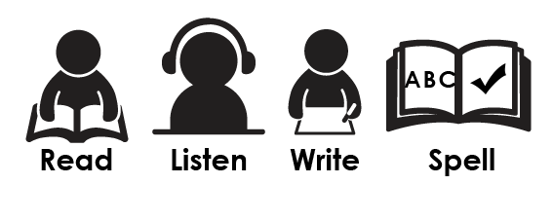
Module Overview
In this beginner module we will explore how to use three apps to support a student with their literacy.
These apps will support the students ability to read, listen, write and spell.
In the intermediate course we will introduce speech to text.

Slide 3
Building Literacy Skills
The app store has thousands of apps under the literacy category. It can be daunting for educators to source a compatible app
that is suitable for all learners and make sure it is supporting
the students learning.

Slide 4
Targeted apps
http://www.callscotland.org.uk/Common-Assets/ckfinder/userfiles/files/Wheel_0f_Apps_V1_0.pdf

Slide 5
First iPad was released in 2010
Remember!
We all know iPads are exciting and there is a plethora of engaging apps,
but do they actually improve education?

Slide 6
Research
Research study, conducted in Auburn, Maine showed that Kindergarten students using iPads scored much higher in literacy test than students that didn’t use the device. 129 students using the iPads 137 without.
Mike Muir, Auburn School, Multiple Pathways Leader
http://www.loopinsight.com/2012/02/17/ipad-improves-kindergartners-literacy-scores/

Slide 7
Research
University of California Irvine medical
school reported iPad equipped medical
students scored 23%higher on national
exams than previously unequipped
classes. Even thought their incoming
GPA scores were comparable.
http://www.mobihealthnews.com/20311/ipad-equipped-medical-school-class-scores-23-percent-higher-on-exams

Slide 8
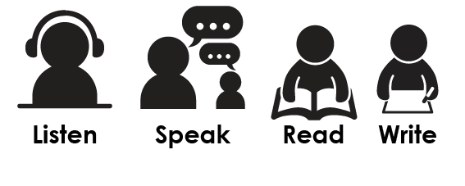
Literacy
The development of Literacy skills is central to all learning for all students.
These skills are developed when the student learns to:
“Literacy includes the ability to use and understand spoken language, print, writing and digital media.”
Literacy and Numeracy for Learning and Life: 2011: 8

Slide 9
During this module we will cover
these Literacy Apps
Claro ScanPen Text to Speech
SnapType Content engagement support writing
Page : Ginger Spelling & Grammar support
Page

