Slide 1
About Me
Core Values and Principles

Slide 2
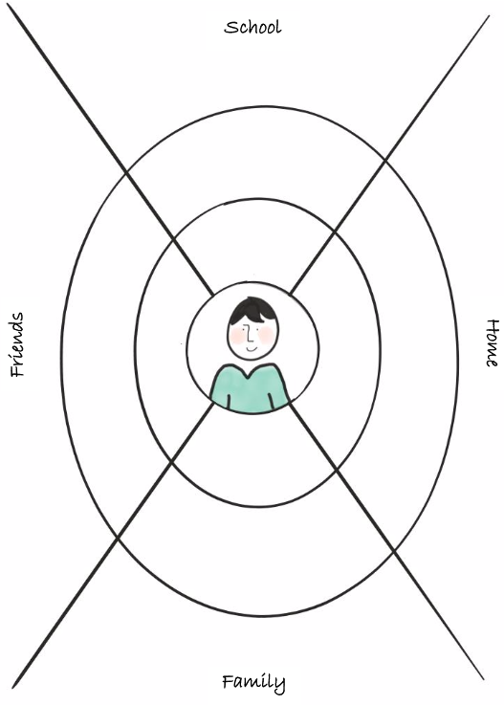
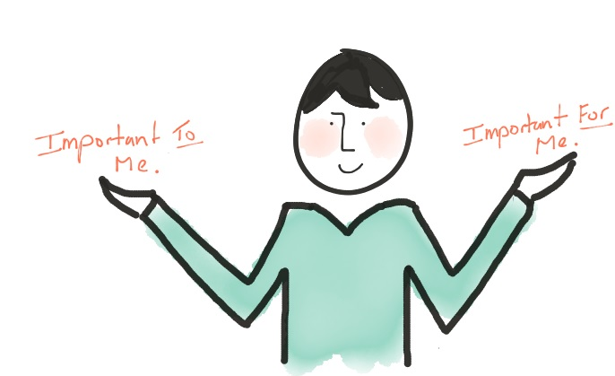
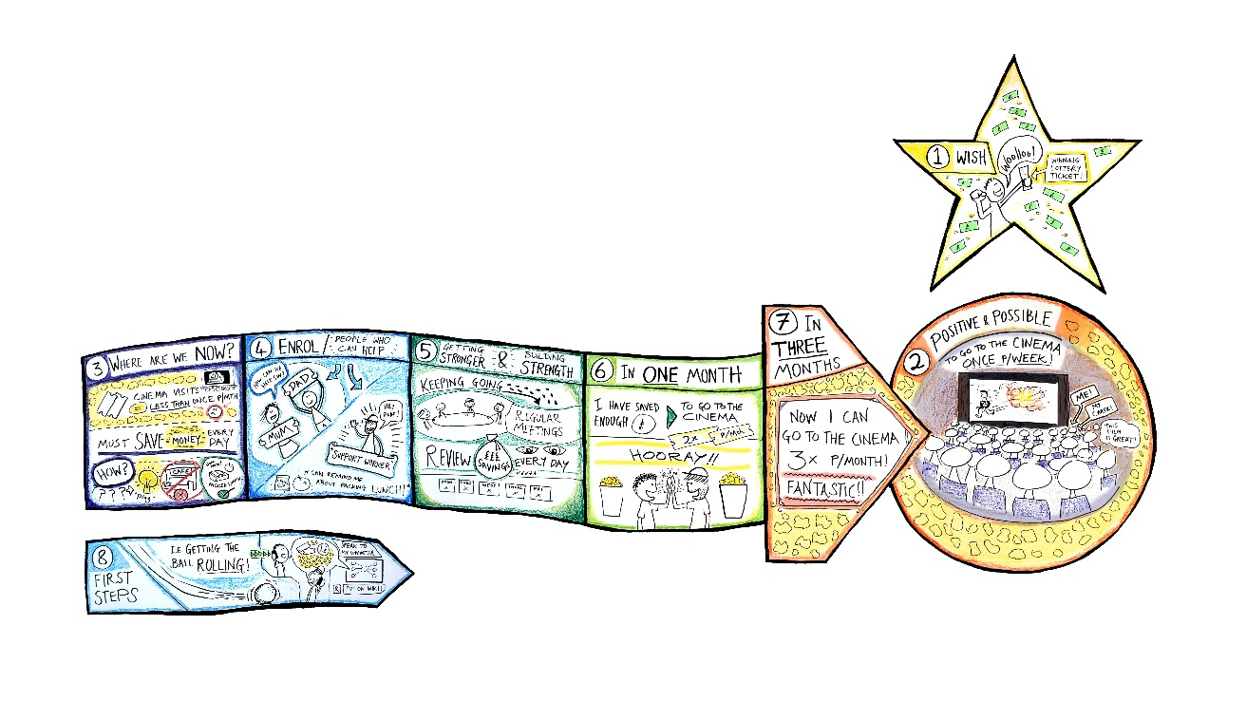
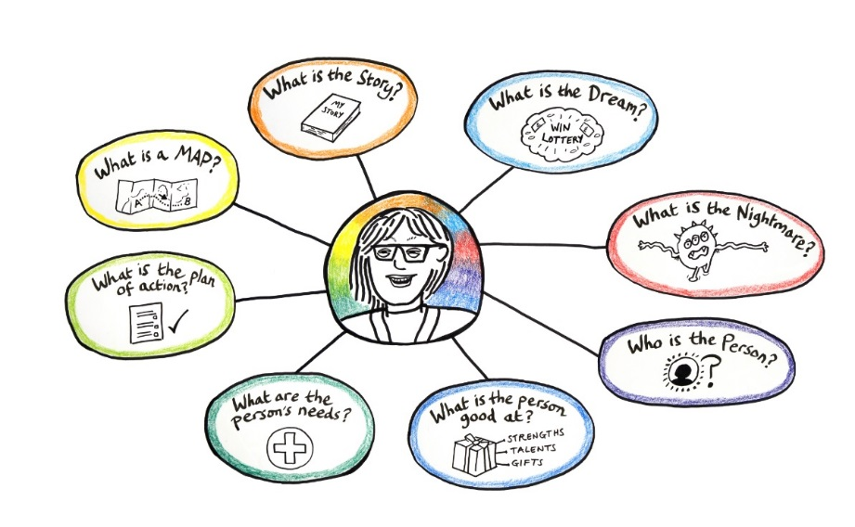
In this module we will look at the core principles of person centred teaching and learning

Slide 3
Person Centred Working Principles in Teaching and Learning
We don’t want to change the person instead we want to change the environment, the processes, design spaces and experiences that work for EACH unique individual.

Slide 4
Principle 1
The learner is at the centre of the learning process

Slide 5
Principle 2
The learner is actively involved

Slide 6
Principle 3
The learner is ‘driving’ the learning process

Slide 7
Principle 4
Teachers and parents are continuously listening and learning from the learner

Slide 8
Principle 5
Teachers, parents and learners are sharing the power

Slide 9
Person Centred Teaching and Learning Values
Beliefs that we adopt as guidelines in our daily activities

Slide 10
Value 1
Children naturally want to learn

Slide 11
Value 2
All learners have the capacity to achieve their full potential

Slide 12
Value 3
All learners have strengths

Slide 13
Value 4
Everyone has something to contribute

Slide 14
Value 5
Self-advocacy, self-determination, autonomy are important for all learners.

Slide 15
Multimedia Advocacy Approach
Using pictures, sound, text, video, art, performance to communicate your views and preferences.

Slide 16
David Test “Self-Advocacy Model”
Knowledge of Self
Knowledge of Rights
Communication
Leadership

Slide 17
Multimedia Advocacy Approach
PCP principles
PCP values
Use multimedia
Follow self-advocacy model

